Slide 1

THE SOUND OF MUSIC – PART 2
The story of Bismillah Khan.

Slide 2

INFORMATION BEFORE WE START - SHEHNAI.
The shehnai is an incredible wind instrument that has been a staple of Indian music for centuries. Crafted from wood and brass, this bell-shaped instrument is designed to create a unique and nasal sound that is both likely and soulful.

Slide 3
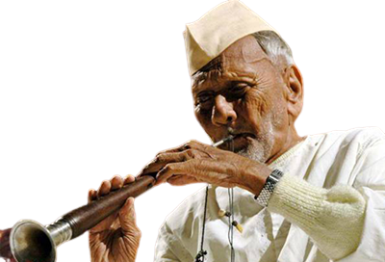
BISMILLAH KHAN.

Slide 4
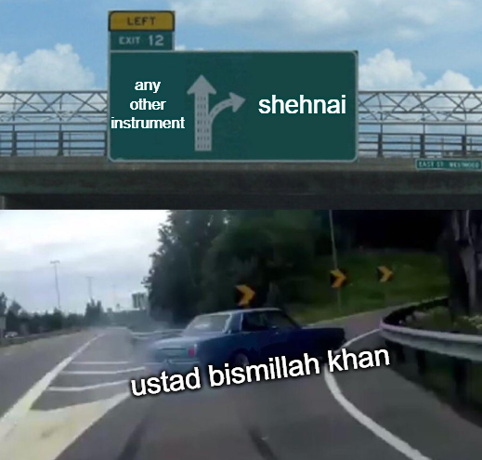

Slide 5
DATE OF BIRTH.
DIED ON
GENRE
BIOGRAPHY.
21st March 1916
21 August 2006
Indian Classical Music.

Slide 6
11 AWARDS!
were given to Ustad Bismillah Khan.

Slide 7
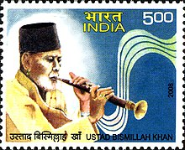
USTAD BISMILLAH KHAN on the stamp of India.

Slide 8
DIVING DEEP INTO THIS STORY.
He chose a pipe with holes in it and played it by closing and opening some of these holes, thereby creating melodious sounds from the instrument. Legendary Indian Shehnai player Ustad Bismillah Khan was the maestro who popularized this musical instrument and gave it a global platform. He belonged to a renowned family of musicians and created new tunes and ragas which had not been explored before. From a young age, he was deeply inspired by the flowing waters of the river Ganga and would play on its banks at the temple of Balaji and Mangala Maiya. Bismillah Khan had a secular upbringing as he loved Benares and would naturally play the shehnai every morning at the Kashi Vishwanath temple on the banks of the holy river Ganga.

Slide 9
DIVING DEEP INTO THIS STORY.
In 1938, Bismillah Khan got his big break with the inauguration of All India Radio in Lucknow. Later, when India became independent of British Rule on 15th August 1947, Ustad Bismillah Khan was the first Indian invited to play the shehnai as he greeted the nation with his stirring performance. Over the years, he achieved infinite success and garnered immense praise from music lovers, both nationally and internationally, for his soulful renditions. He was bestowed with several accolades and awards in India, such as the Padma Vibhushan, the Padma Bhushan and the Padma Shri. He was also the recipient of the highest civilian honour in India, i.e. The Bharat Ratna.

Slide 10
DIVING DEEP INTO THIS STORY.
Ustad Bismillah Khan represented India on the global stage too. He was the first Indian who was invited to perform at the distinguished Lincoln Centre Hall in the USA. He also participated in the Cannes Art Festival, the World Exposition in Montreal and the Osaka Trade Fair. He was so popular that an opera house in Teheran was named after him, i.e. Tahar Mosiquee Ustaad Bismillah Khan. Despite having numerous opportunities far and wide, the music maestro was very fond of India, particularly Benaras and his native town, Dumraon. On 21st August 2006, Ustad Bismillah Khan breathed his last after a prolonged illness and left a legacy of soulful music behind him.

